Slide 1
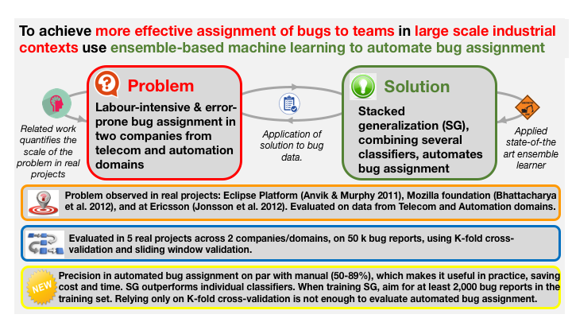
Notes:
Jonsson, Leif, et al. "Automated bug assignment: Ensemble-based machine learning in large scale industrial contexts." Empirical Software Engineering 21.4 (2016): 1533-1578.
@article{jonsson2016automated, title={Automated bug assignment: Ensemble-based machine learning in large scale industrial contexts}, author={Jonsson, Leif and Borg, Markus and Broman, David and Sandahl, Kristian and Eldh, Sigrid and Runeson, Per}, journal={Empirical Software Engineering}, volume={21}, number={4}, pages={1533--1578}, year={2016}, publisher={Springer} }

